Slide 1


Discrimination & Mental Health v. Unemployment
By Shweta Govind

Slide 2
Introduction
There are several factors that can cause bias in unemployment statistics(e.g. mental state, educational background, annual income)
Important to take note of such factors and see what causes these statistics to skew
Conducted exploratory analysis to see connection between mental state and unemployment

Slide 3
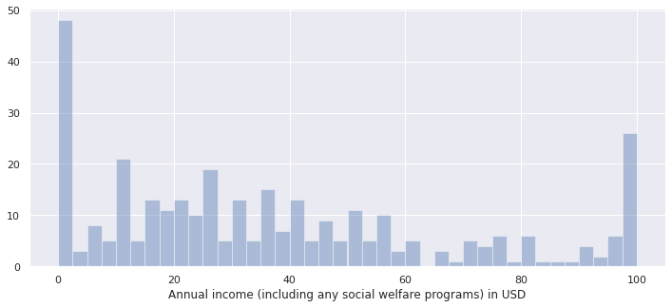
Distribution of Annual Income

Slide 4
CORRELATION STATISTICS
 | I am unemployed | Depression | ANXIETY
I am unemployed | 1.000000 | 0.170011 | 0.168219
Depression | 0.170011 | 1.000000 | 0.586840
Anxiety | 0.168219 | 0.586840 | 1.000000

Slide 5
Research QUestions
Research Question #1: Is there a higher frequency of unemployment for those 45 - 60?
Research Question #2: Is there a higher frequency of unemployment among Females vs. Males?

Slide 6
HYPOTHESES FOR RESEARCH QUESTION #1
Ho: There is no difference in the means of unemployment between those who are under the age of 45 and those who are 45-60
Ha: There is a significant difference in the means of unemployment between those who are under the age of 45 and those who are 45-60

Slide 7
RESULTS of Two Sample T-Test
Two Groups: Age 18-29 and Age 45-60
statistic=-1.76
P-value=0.08
Given the p-value is > 0.05, fail to reject the null hypothesis that there is no difference in the means of unemployment frequency between the 2 age groups

Slide 8
HYPOTHESES FOR RESEARCH QUESTION #2
Ho: There is no difference in the means of unemployment between Males and Females
Ha: There is a significant difference in the means of unemployment between Males and Females

Slide 9
RESULTS OF two Sample T-Test
Two Groups: Male and Female
statistic=-1.17
P-value=0.24
Given the p-value is > 0.05, fail to reject the null hypothesis that there is no difference in means of unemployment frequency btwn. Males and Females

Slide 10
Answers to Research Questions
No, there is not a higher frequency of unemployment for those 45 – 60
No, there is not higher frequency of unemployment among Females vs. Males

